Slide 1
Identification of Medicinal Plants using Deep Learning Techniques

Slide 2
Index
Abstract
Introduction
Literature review
Existing Method
Disadvantages
Proposed method
Block Diagram
Advantages
Implementation
Modules
Algorithms
Architecture
UML diagrams
Class Diagram
Sequence Diagram
Collaboration Diagram
Deployment Diagram
Activity Diagram
Component Diagram
Results
Conclusion
Future Scope
Hardware and Software Requirements
References

Slide 3
Abstract
The Therapeutic nature of medicinal plants and their ability to heal many diseases raises the need for their automatic identification. Different parts of plants that help in their identification include root,fruit,bark,stem but leaf image have been widely used as they are an abundant source of information and are also easily available. This work explores the branch of Artificial Intelligence, called deep learning, and proposes an Ensemble learning apporach to rapidly detect medicinal plants using the leaf image.
The lighting condition of the environment are uncontrolled, so the segmentation of a leaf from the background is considered as a complex task. Here we propose a system which can identify the plant species based on the input leaf sample. An improved vegetation index.
ExG-ExR is used to obtain more vegetative information from the images. The reason here is, it fixes a built-in zero threshold and hence there is no need to use otsu or any threshold value selected by the user. Inspite of the existence of more vegetative information in ExG with otsu method, our ExG-ExR index works well irrespective of the lighting background. Therefore, the ExG-ExR index identifies a binary plant region of interest. The original color pixel of the binary image serves as the mask which isolates leaves as sub-images.

Slide 4
introduction
Medicinal Plants are fundamental to the equalization of nature and in individuals lives. They are the source of medicine. Thus, the identification of the medicinal plants is important because medicinal plants are the fundamental part of life on the Earth and allows humans and other organisms to exist by generating the oxygen and food. An advanced plant identification system can be used for quick characterization of medicinal plant species without requiring the expert advice, thus automizing their task.
Identification of plants based on the flowers and fruits needs morphological features. Those features are the number of stamens in flower and number of ovaries in fruits. Distinguishing these plants by using the keys is an extremely tedious process and are done only by the botanists.

Slide 5
LITERATURE SURVEY
SL NO | Journal type with year | Authors | Title | Outcomes
01 | Springer Nature Switzerland 2022 | Silky Sachar Anuj Kumar | Deep ensemble learning for automatic medicinal leaf identifcation | The therapeutic nature of medicinal plants and their ability to heal many diseases raises the need for their automatic identifcation. Diferent parts of plants that help in their identifcation include root, fruit, bark, stem but leaf images have been widely used as they are an abundant source of information and are also easily available
02 | MDPI 2021 | Aqib Ali Samreen Naeem Christophe Chesneau & team | The Classification of Medicinal Plant Leaves Based on Multispectral and Texture Feature Using Machine Learning Approach | This study proposes the machine learning based classification of medical plant leaves. These plants are commonly named in English as (herbal) Tulsi, Peppermint, Bael, Lemon balm. The multispectral and digital image dataset are collected via a computer vision laboratory setup
03 | Springer 2022 | Silky Sachar Anuj Kumar | Deep ensemble learning for automatic medicinal leaf identifcation | The therapeutic nature of medicinal plants and their ability to heal many diseases raises the need for their automatic identifcation. Diferent parts of plants that help in their identifcation include root, fruit, bark, stem but leaf images have been widely used as they are an abundant source of information and are also easily available.
04 | IJRASET, 2022 | R. Upendar Rao M. Sai Lahari K. Pavana Sri | Identification of Medicinal Plants using Deep Learning | Identification of the correct medicinal plants that goes in to the preparation of a medicine is very important in ayurvedic, folk and herbal medicinal industry. The main features required to identify a medicinal plant is its leaf shape, color and texture. Color and texture from both sides of the leaf contain deterministic parameters to identify the species

Slide 6
Existing method
In the existing there are methods implemented to classify medical plant classification in deep learning. In method we are performing the classification medical plant identification using Resnet, vgg16 of deep learning along with the Machine learning methods. As image analysis based approaches for classification of medical plant

Slide 7
disadvantages
Less accuracy.
More Losses.

Slide 8
PROPOSED SYSTEM
In purposed method we are performing the classification of either the image is medical plant identification using Mobile net of deep learning along with the Machine learning methods. As image analysis based approaches for medical plant classification and authentication. Hence, proper classification is important for the medical plant that which will be possible by using our proposed method. Block diagram of proposed method is shown below.

Slide 9
advantages
Accurate classification
Less complexity
High performance
Easy Identification

Slide 10
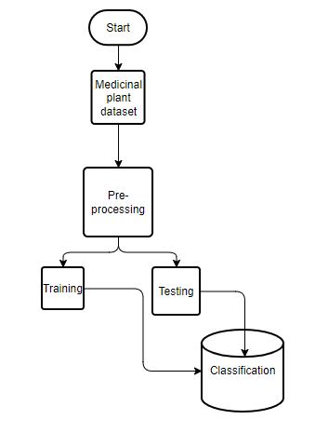
BLOCK DIAGRAM

Slide 11
IMPLEMENTATION
First we have taken the medical plant images.
Load the dataset into and Preprocessing .
Here split the data in to train data and test data.
After splitting apply the Mobile net algorithm and fit the train data and test data.
We got the best accuracy score for Mobile Net.
Later, the entire work is done with Flask framework
User can view the home, about ,upload page and Results.

Slide 12
Modules
1. System:
1.1 Create Dataset:
The dataset containing images medical plant images with the 2 classes which are to be classified is split into training and testing dataset with the test size of 30-20%.
1.2 Pre-processing:
Resizing and reshaping the images into appropriate format to train our model.
1.3 Training:
Use the pre-processed training dataset is used to train our model using Mobilenet algorithm.
1.4 Classification:
The results of our model is display of classified.

Slide 13
module
2. User:
2.1 Check accuracy
The user can check for the training accuracy of the model.
2.2 Upload Image
The user has to upload an image which needs to be classified.
2.3 View classified output
The classified image results are viewed by user.
2.4 View predicted diseases
The predicted diseases of classified images are viewed by user.

Slide 14
Algorithm
Mobile Net:
MobileNet is an efficient and portable CNN architecture that is used in real world applications. Mobile Nets primarily use depth wise separable convolutions in place of the standard convolutions used in earlier architectures to build lighter models.MobileNets introduce two new global hyper parameters(width multiplier and resolution multiplier) that allow model developers to trade off latency or accuracy for speed and low size depending on their requirements.

Slide 15
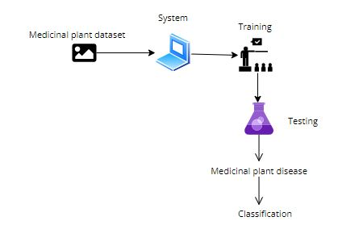
ARCHITECTURE

Slide 16
UML DIAGRAMS
A use case diagram in the Unified Modeling Language (UML) is a type of behavioral diagram defined by and created from a Use-case analysis. Its purpose is to present a graphical overview of the functionality provided by a system in terms of actors, their goals (represented as use cases), and any dependencies between those use cases. The main purpose of a use case diagram is to show what system functions are performed for which actor. Roles of the actors in the system can be depicted.

Slide 17
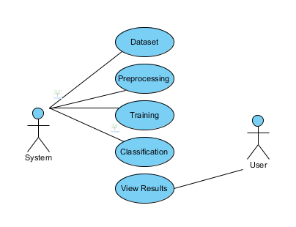

Slide 18
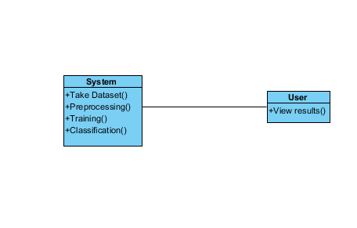
CLASS DIAGRAM
In software engineering, a class diagram in the Unified Modeling Language (UML) is a type of static structure diagram that describes the structure of a system by showing the system's classes, their attributes, operations (or methods), and the relationships among the classes. It explains which class contains information

Slide 19
SEQUENCE DIAGRAM
A sequence diagram in Unified Modeling Language (UML) is a kind of interaction diagram that shows how processes operate with one another and in what order. It is a construct of a Message Sequence Chart. Sequence diagrams are sometimes called event diagrams, event scenarios, and timing diagrams.

Slide 20
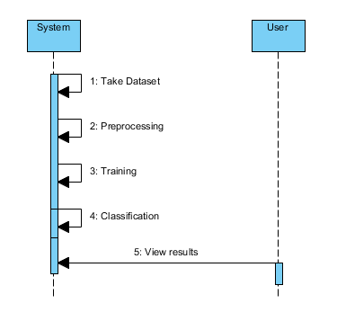

Slide 21
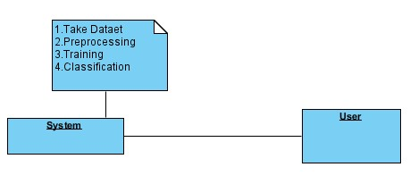
COLLABORATION DIAGRAM
In collaboration diagram the method call sequence is indicated by some numbering technique as shown below. The number indicates how the methods are called one after another. We have taken the same order management system to describe the collaboration diagram. The method calls are similar to that of a sequence diagram. But the difference is that the sequence diagram does not describe the object organization where as the collaboration diagram shows the object organization

Slide 22
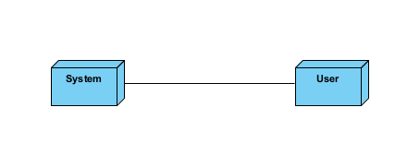
DEPLOYMENT DIAGRAM
Deployment diagram represents the deployment view of a system. It is related to the component diagram. Because the components are deployed using the deployment diagrams. A deployment diagram consists of nodes. Nodes are nothing but physical hardware used to deploy the application

Slide 23
ACTIVITY DIAGRAM
Activity diagrams are graphical representations of workflows of stepwise activities and actions with support for choice, iteration and concurrency.
In the Unified Modeling Language, activity diagrams can be used to describe the business and operational step-by-step workflows of components in a system.
An activity diagram shows the overall flow of control.

Slide 24
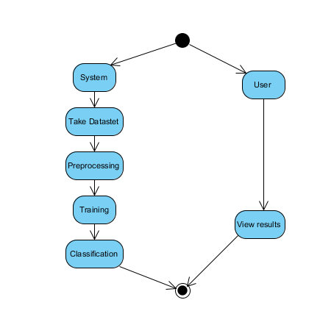

Slide 25
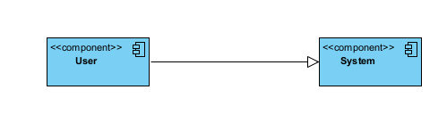
COMPONENT DIAGRAM
A component diagram, also known as a UML component diagram, describes the organization and wiring of the physical components in a system.
Component diagrams are often drawn to help model implementation details and double-check that every aspect of the system's required functions is covered by planned development.

Slide 26
Results
In this application, we have considered the dataset Medicinal plant trained using Mobile net algorithm along with Deep learning and ANN machine learning methods.
In the testing the image is uploaded and the image is classified.

Slide 27
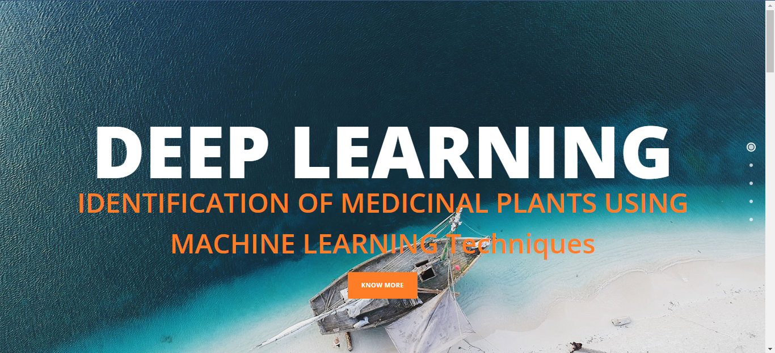
Results and discussion
Home page

Slide 28
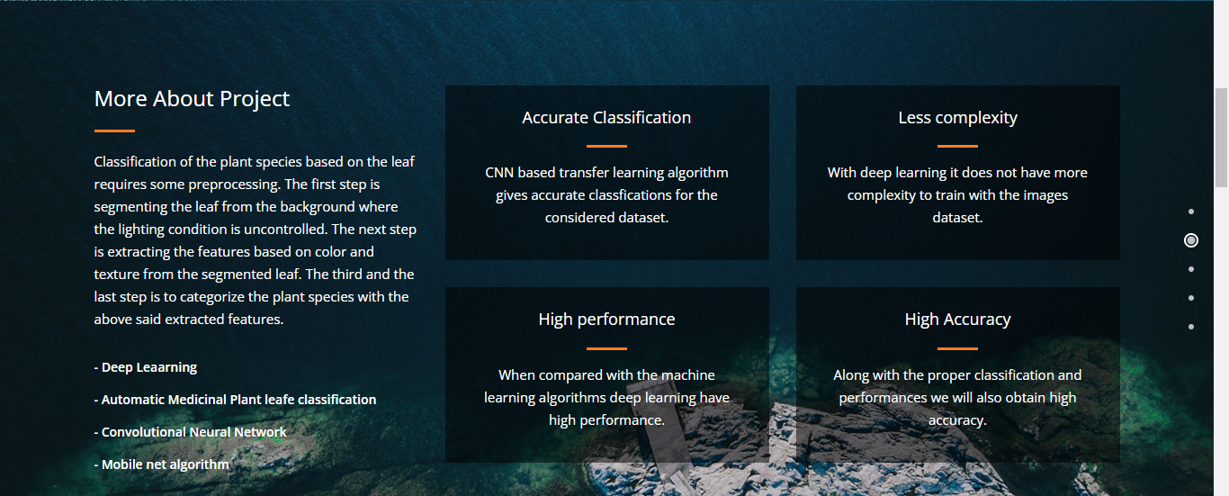
About

Slide 29

Technologies used

Slide 30

Upload

Slide 31

Result

Slide 32
CONCLUSION
In this project we have successfully classified the images of Medicinal plant, are either matching with each other using the deep learning and Transfer learning. Here, we have considered the dataset of Medicinal plant which will be of different types trained using Mobile net, transfer learning method. After the training we have tested by uploading the image and classified

Slide 33
FUTURE SCOPE
This can be utilized in future to classify and detect the different types of unique Medicinal plants to classify accurately and use for rare diseases and make a difference in identifying and early treatment..

Slide 34
HARDWARE AND SOFTWARE REQUIREMENTS
H/W Specifications:
Processor : I5/Intel Processor
RAM : 8GB (min)
Hard Disk : 128 GB
S/W Specifications:
Operating System : Windows 10
Server-side Script : Python 3.6
IDE : PyCharm, Jupyter notebook
Libraries Used : Numpy, IO, OS, Flask, Keras, pandas, tensorflow

Slide 35
references
Parekh J, Chanda S (2010) Antibacterial and phytochemical studies on twelve species of Indian medicinal plants. Afr J Biomed Res 10:175–181. https://doi.org/10.4314/ajbr.v10i2.50624
Benarba B, Pandiella A (2018) Colorectal cancer and medicinal plants: principle fndings from recent studies. Biomed Pharmacother 107:408–423. https://doi.org/10.1016/j.biopha.2018.08.006
Adhikari B, Marasini BP, Rayamajhee B et al (2021) Potential roles of medicinal plants for the treatment of viral diseases focusing on COVID-19: a review. Phyther Res 35:1298–1312. https:// doi.org/10.1002/ptr.6893
de Freitas Junior LM, de Almeida EB (2017) Medicinal plants for the treatment of obesity: ethnopharmacological approach and chemical and biological studies. Am J Transl Res 9:2050–2064
Wäldchen J, Mäder P (2018) Plant species identifcation using computer vision techniques: a systematic literature review. Arch Comput Methods Eng 25:507–543. https://doi.org/10.1007/ s11831-016-9206-z
Sachar S, Kumar A (2020) Survey of feature extraction and classifcation techniques to identify plant through leaves. Expert Syst Appl. https://doi.org/10.1016/j.eswa.2020.114181

Slide 36
Thank you

